Slide 1
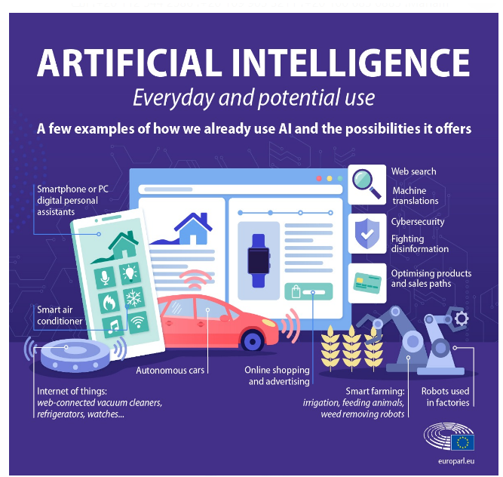

Slide 2
What is ARTIFICIAL INTELLIGENCE

Slide 3
What is ARTIFICIAL INTELLIGENCE

Slide 4
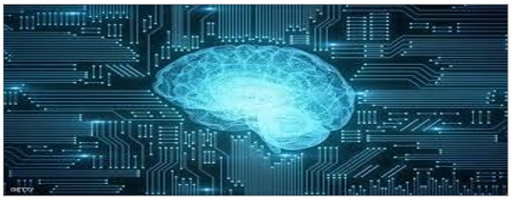
What is ARTIFICIAL INTELLIGENCE
Research in AI has focused chiefly on the following components of intelligence: learning, reasoning, problem solving,perception.

Slide 5
Importance of Artificial intelligence
Artificial intelligence forms the basis for all computer learning and is the future of all complex decision making.
1)AI is important because, for the first time, traditionally human capabilities can be undertaken in software inexpensively and at scale. AI can be applied to every sector to enable new possibilities and efficiencies.

Slide 6
Importance of Artificial intelligence
2)it enables human capabilities – understanding, reasoning, planning, communication and perception – to be undertaken by software increasingly effectively, efficiently and at low cost.
3)General analytical tasks, including finding patterns in data, that have been performed by software for many years can also be performed more effectively using AI.
4)The automation of these abilities creates new opportunities in most business sectors and consumer applications.

Slide 7
Importance of Artificial intelligence
5)Significant new products, services and capabilities enabled by AI include autonomous vehicles, automated medical diagnosis, voice input for human-computer interaction, intelligent agents, automated data synthesis and enhanced decision-making.
6)AI has numerous, tangible use cases today that are enabling corporate revenue growth and cost savings in existing sectors.
7)Applications will be most numerous in sectors in which a large proportion of time is spent collecting and synthesizing data: financial services, retail and trade, professional service,

Slide 8
Importance of Artificial intelligence
manufacturing and healthcare. Applications of AI-powered computer vision will be particularly significant in the transport sector.
8)Use cases are proliferating as AI’s potential is understood. We describe 31 core use cases across eight sectors: asset management, healthcare, insurance, law & compliance, manufacturing, retail, transport and utilities.

Slide 9
Courses for artificial intelligence
linear algebra
Linear regression with single and multiple variables
IBM Data Science professional Certificate
Logistic regression and its applications
Artificial Intelligent Reinforcement Learning in Python
Support trend machines, neural networks, backpropagation algorithms

Slide 10
مريم جاب الله عزيز سعد
مريم ماهر زكرى
محمود محمد احمد محمد
مصطفى اشرف على
مصطفى محمود محمد خليفه

